Slide 1
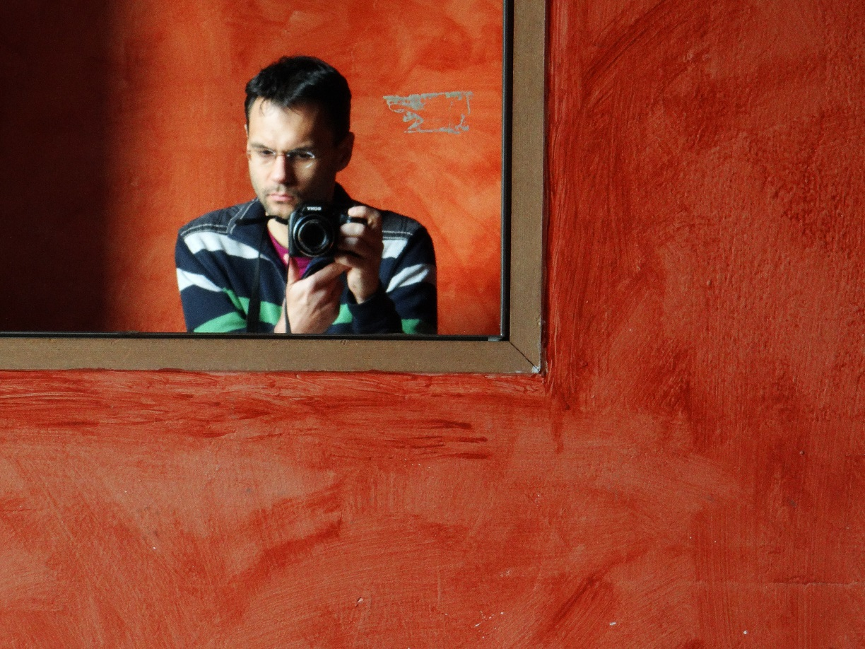
Igor Rončević
about.me/ironcev

Slide 2

www.avl.com

Slide 3
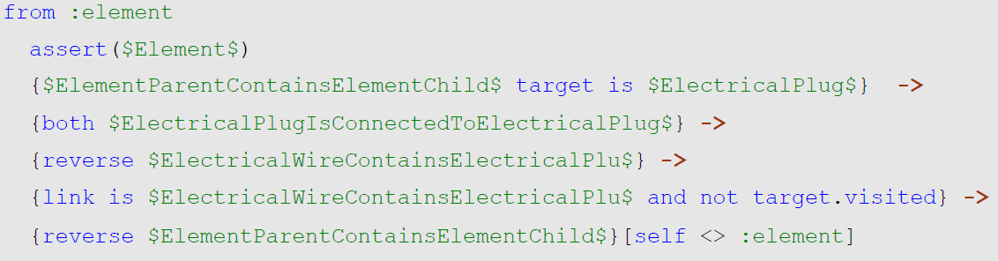
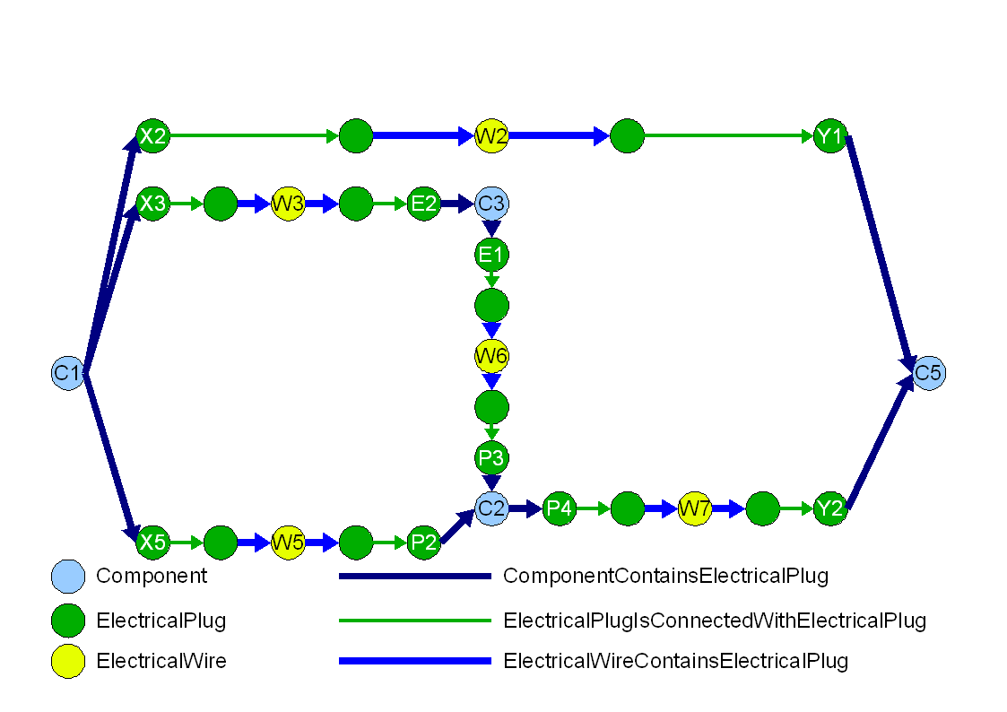
www.avl.com

Slide 4
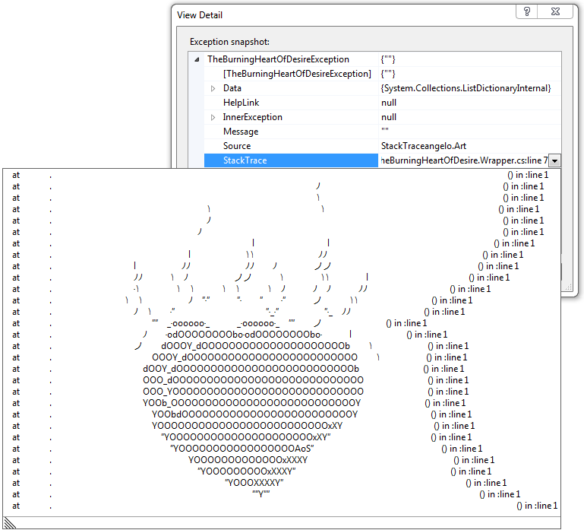
Stack Trace Art
www.avl.com
thehumbleprogrammer.com/stack-trace-art

Slide 5
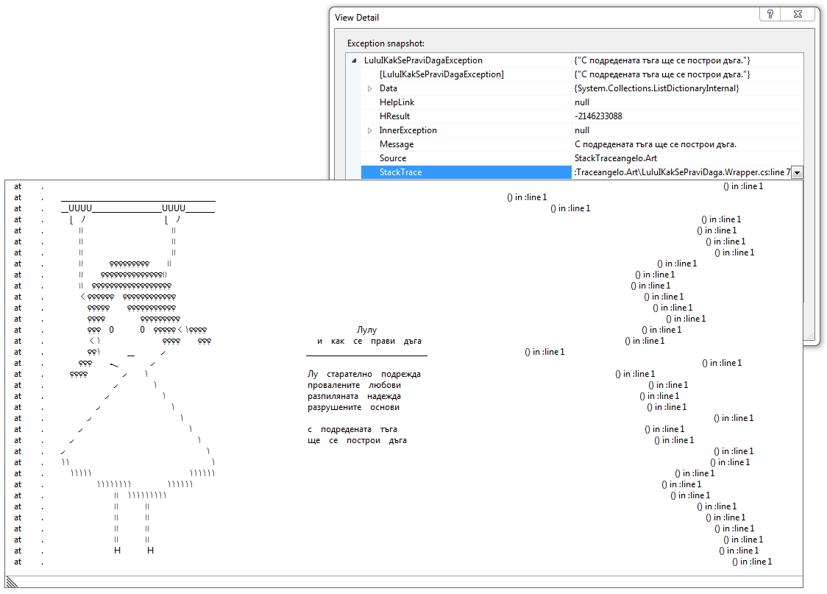
thehumbleprogrammer.com/stack-trace-art
www.avl.com

Slide 6
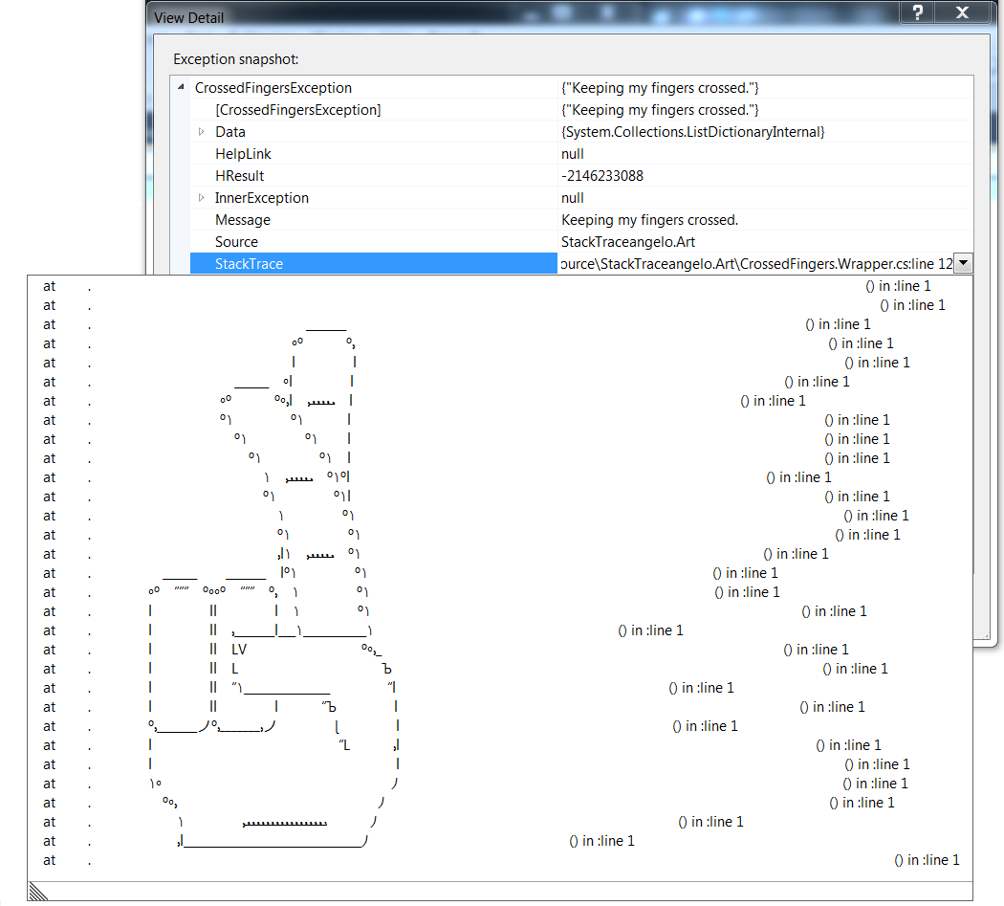
thehumbleprogrammer.com/stack-trace-art
www.avl.com

